Slide 1






PRESENTATION 2026
EduSync: Intelligent Onboarding Agent for Academic Excellence
Transforming Policy Management through AI
Mentor Name
Student Name
Student Email
Umamaheswari
Chaitali Dusane
Chaitali.dusane1006@gmail.com

Slide 2
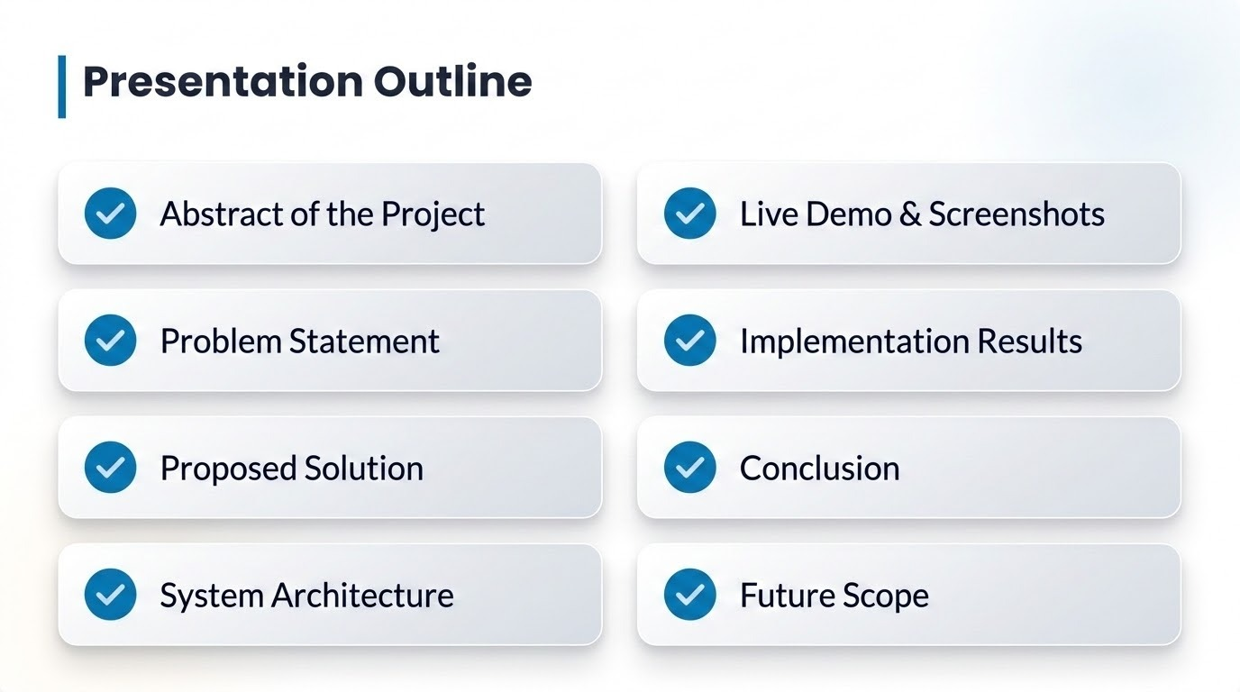

Slide 3



Abstract
Project Overview
Core Impact
EduSync is an AI-powered conversational agent developed using Microsoft Copilot Studio to modernize the onboarding experience for new faculty members.
By centralizing scattered institutional policies into one intelligent interface, the project reduces manual HR effort by up to 40% while providing instant, 24/7 support.

Slide 4
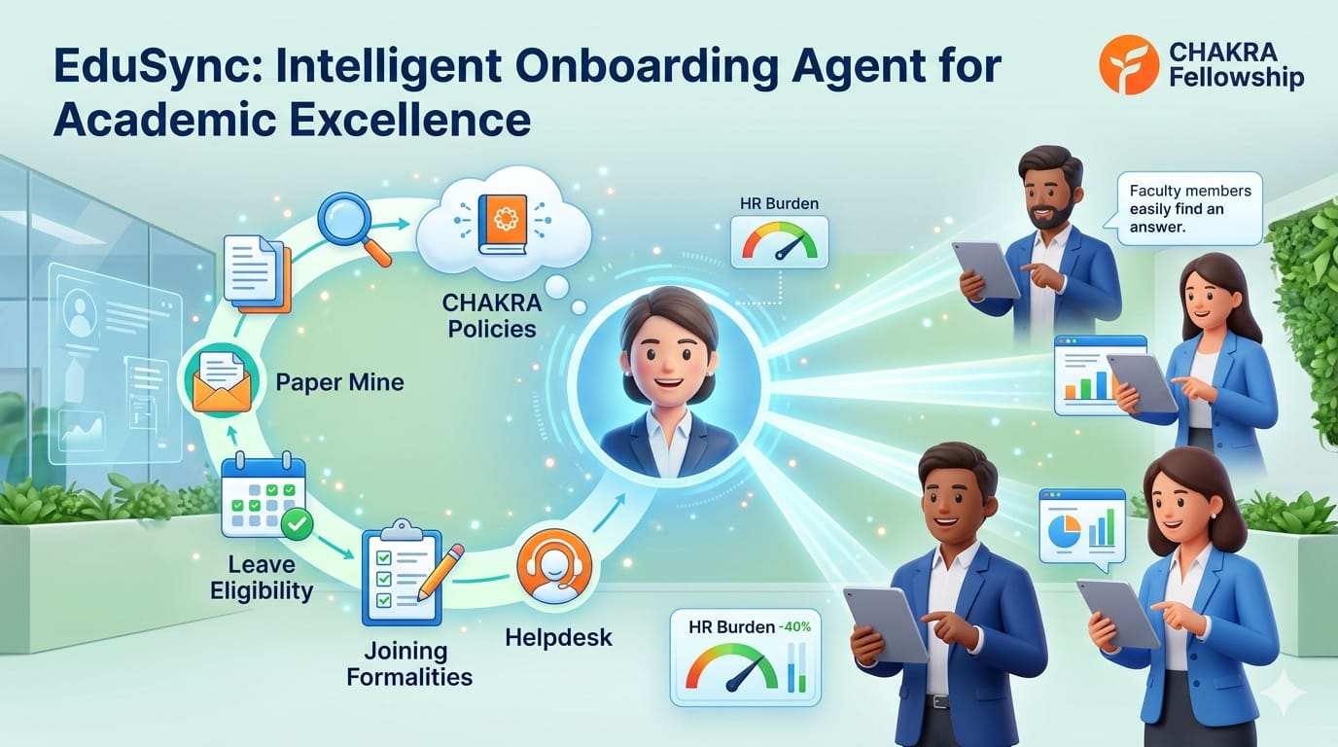
Problem Statement
Institutional policies often exist in a "Paper Mine" state, causing friction during critical transitions.
Information Silos: Data scattered across manuals and emails.
Admin Burden: HR staff repeat same answers to routine queries.
Inconsistency: Risk of outdated policy information being shared.

Slide 5




Proposed Solution
EduSync AI Concierge
Unified Knowledge Base
An interactive digital assistant that answers HR and administrative questions instantly using Generative AI.
Consolidation of University policies (Leave, IT, Joining) into a single AI-digestible repository.
Primary Tools: Microsoft Copilot Studio & Microsoft 365

Slide 6





System Architecture

Slide 7
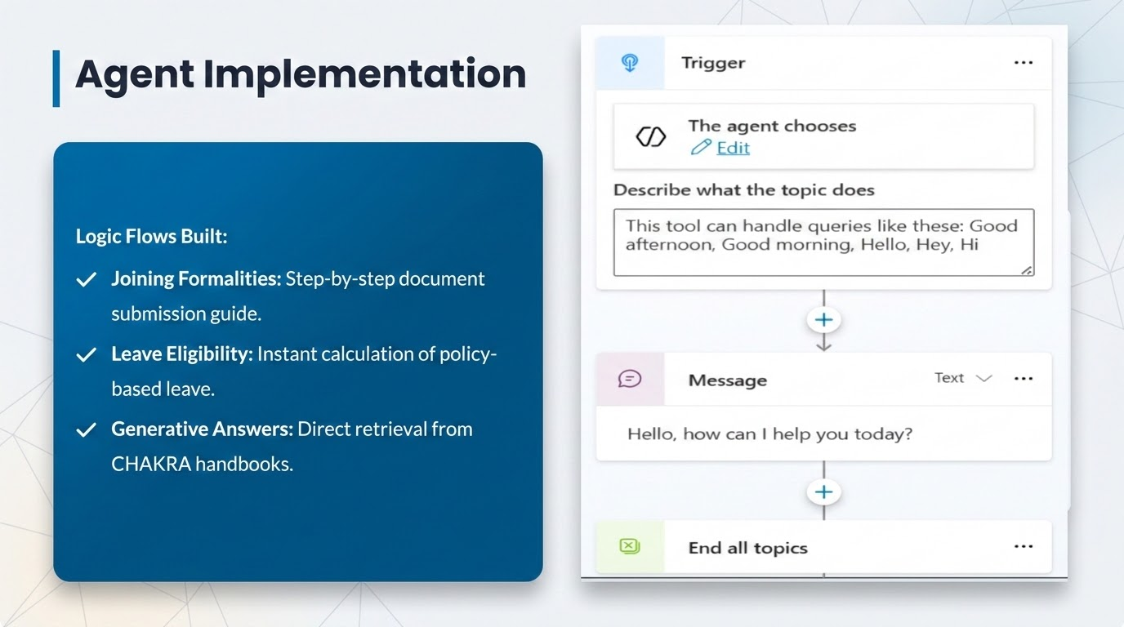

Slide 8
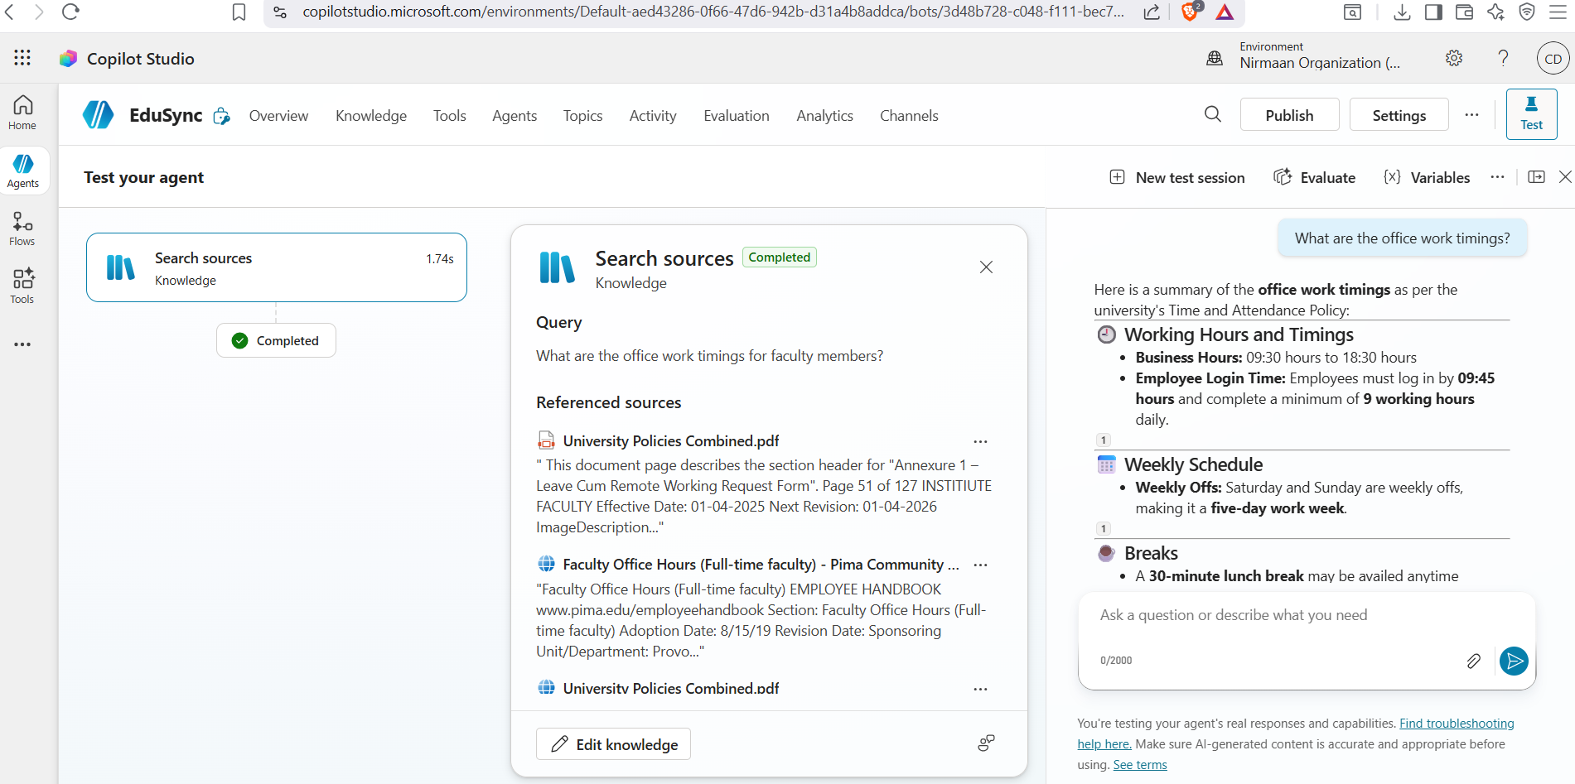
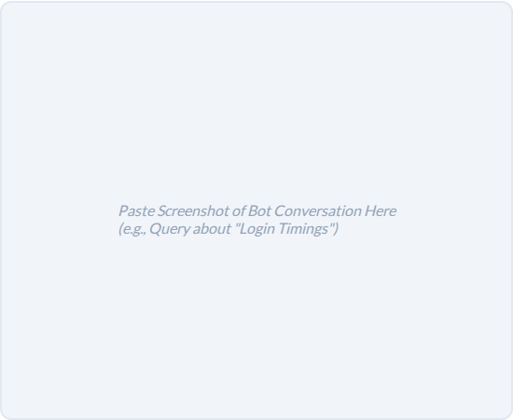

Live Demo: Test Bot Response
Key Test Scenarios:
Query: "What time should I login?"
Response: "Per CHAKRA policy, login flexibility is until 09:45 AM."
Query: "Documents for day 1?"
Response: Guides user to the Annexure V list instantly.

Slide 9
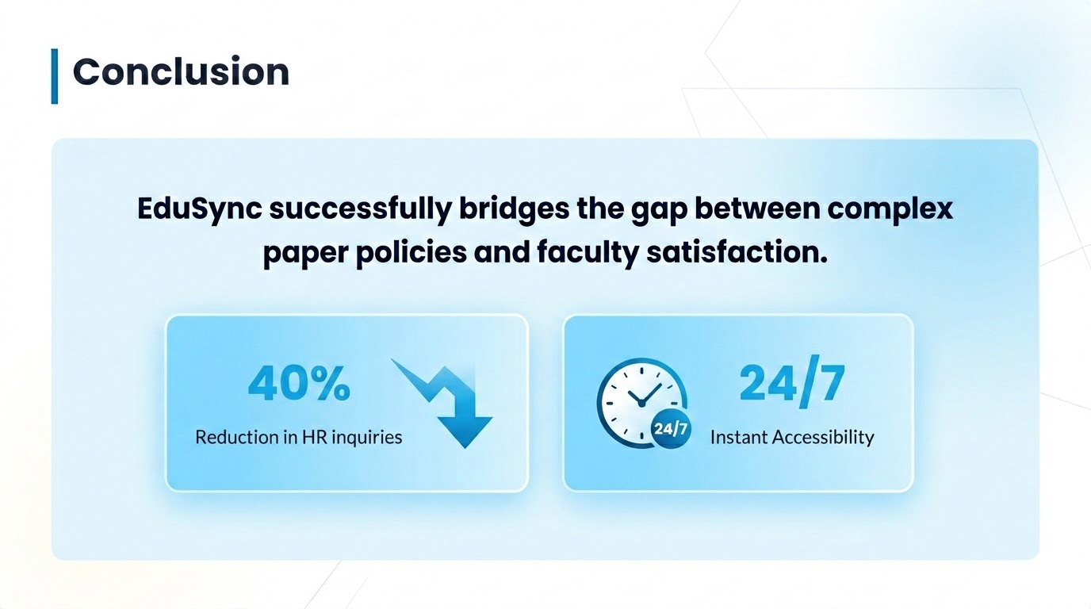

Slide 10
Future Scope
Live HRMS Integration: Real-time leave balance tracking.
Predictive Insights: Analyzing common faculty pain points.
Multi-lingual Support: Policies available in regional languages.
Institutional Scaling: Deploying to other admin departments.

Slide 11
